Slide 1
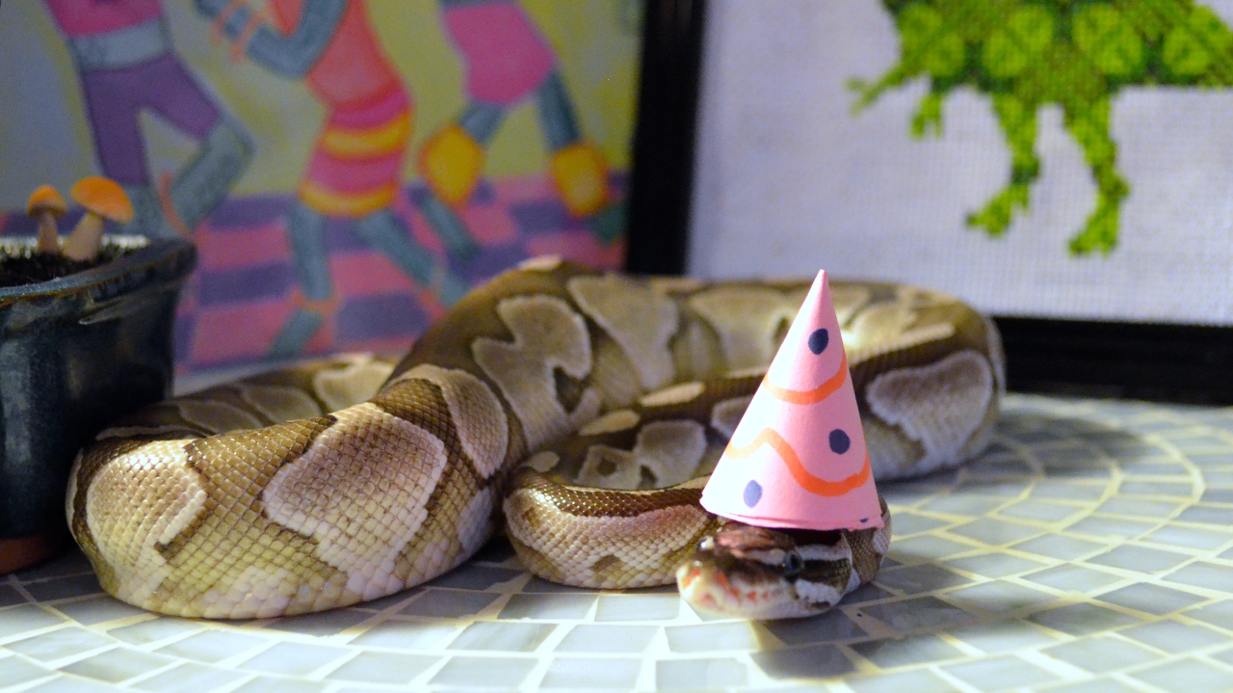
Snakes And Ladders Unique Ideas
Zach Ahearn K00282339

Slide 2

Methods to Design the Game
Players start at p1score=0 & p2score=0
Dicesum = Dice1 + Dice2 – Dice3 | p1score = p1score + dicesum
value Game is won when player ‘score’ >= 100
Dice is a simple random number generator, the dice sum adding to the players score
Specific positions will have a snake or ladder, if playerscore=[snake/ladder position], then the respective event takes place
Entire game is in a do-while loop until either players’ score is >=100

Slide 3
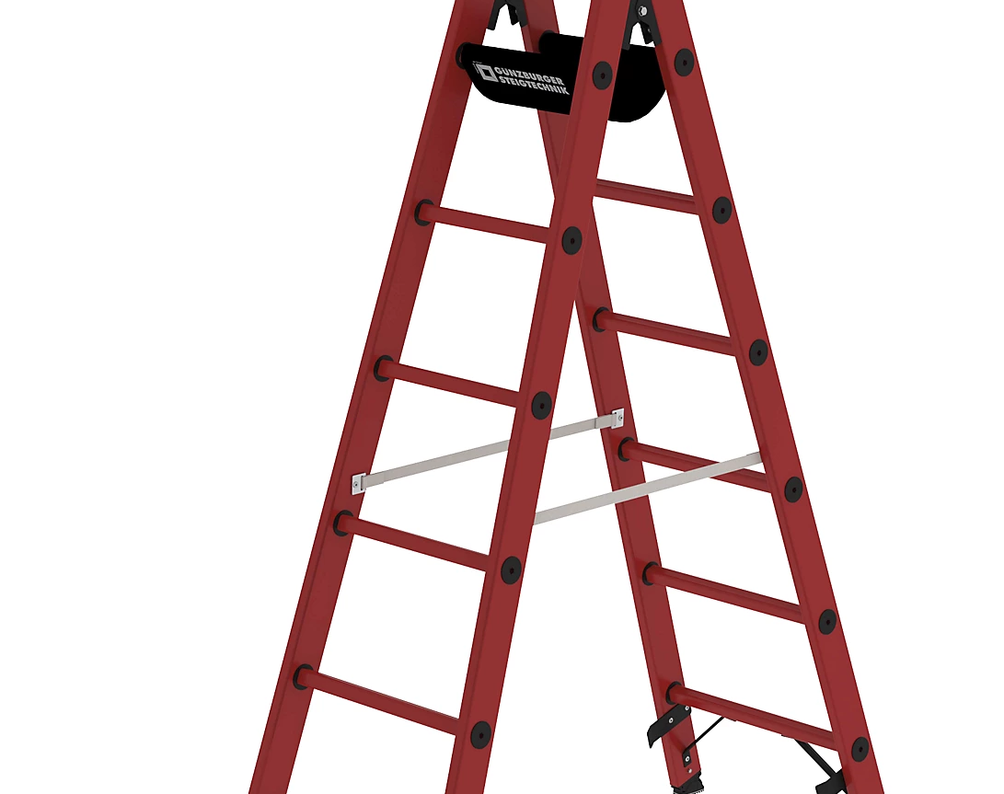
Idea 1:
The ability to save yourself from a snake when a 6 is rolled
Makes for close calls
Random number generator and if-else statements

Slide 4
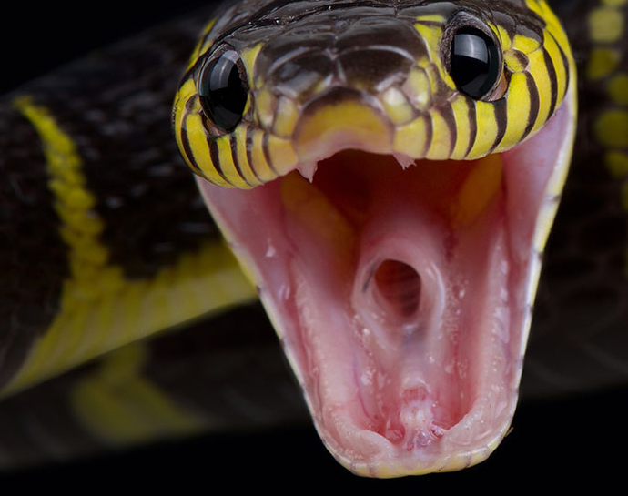
Idea 2:
3 dice rolls
2 add, one subtracts
Increases game length
Adds to the existing random luck
Simple sum

Slide 5
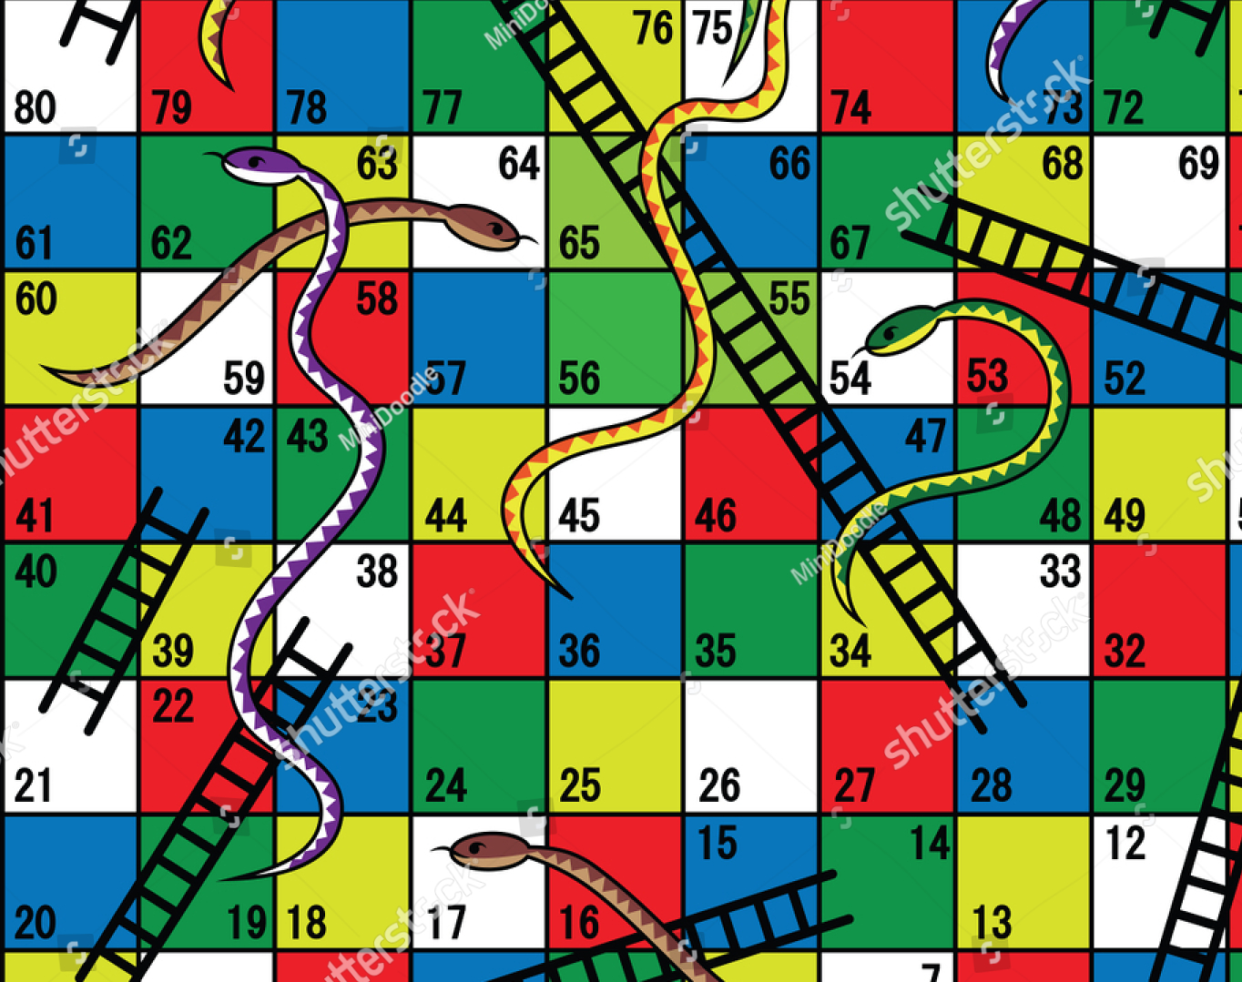
Idea 3:
Roll 0, player who rolled moves to other player’s positions
Adds to the second idea
Makes for sometimes frustrating gameplay, but also comeback moments when the player is way behind
If-statements and p1score=p2score and vice-versa

Slide 6

Idea 4:
Roll below 4 on ladder, value increase is halved
Reduces effectiveness of ladders with poor luck
High stakes when you're losing or are close to the end
If-else statements and random number generator

Slide 7
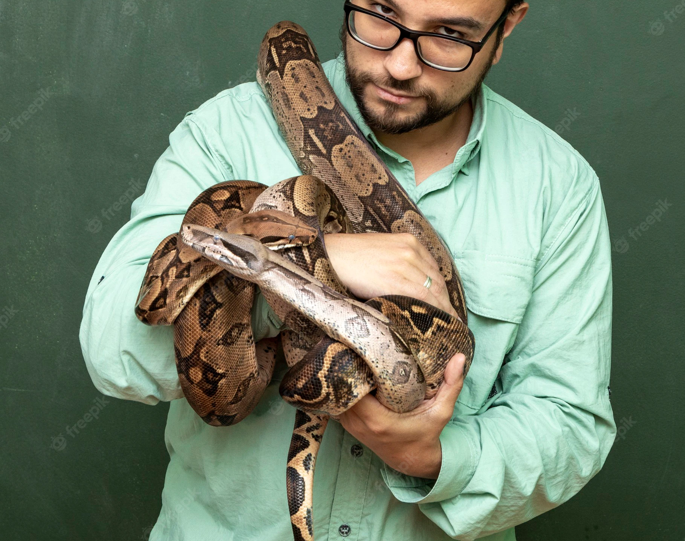
Idea 5:
Go up a ladder, set back opponent 2 spaces
Adds to Idea 4
A means to negatively affect your opponent
Makes going up a ladder even more rewarding
Will not apply to first ladder to avoid player 2 being set into negative position before their first turn
If-else statements and reduce the value of the opponent's position

